Slide 1

Capstone PROJECT REVIEW

Slide 2
Project Name: GearUp – Vehicle Service Management System Tech Stack: Spring Boot | Angular | Microservices
Srihari Eetyala | CHUBB| Jan 6th 2025

Slide 3
Abstract
GearUp is a cloud-based Vehicle Service Management System implemented using a microservices architecture to modernize automobile service operations. The system replaces manual and fragmented workflows by enabling digital appointment booking, real-time service status tracking, structured task assignment, and centralized inventory management. It support 5 user role Customers, Technicians, Managers, Inventory Managers, and Administrators , each with clearly defined responsibilities and dashboards..

Slide 4
Problem statement
Lack of centralized visibility across vehicle service requests and operations
Inefficient utilization of technicians and service resources
Delays caused by poor spare parts and inventory management
Limited customer transparency and management-level insights

Slide 5
Solution overview

Slide 6
TECH STACK
Backend Java 21, Spring Boot, Spring Security, Spring Data JPA, JWT, Spring Cloud (Gateway, Eureka, Config), RabbitMQ
Frontend Angular 20, TypeScript, Bootstrap , html
Infrastructure & Tools Docker, PostgreSQL, GitHub, Jenkins, Postman, SonarQube

Slide 7
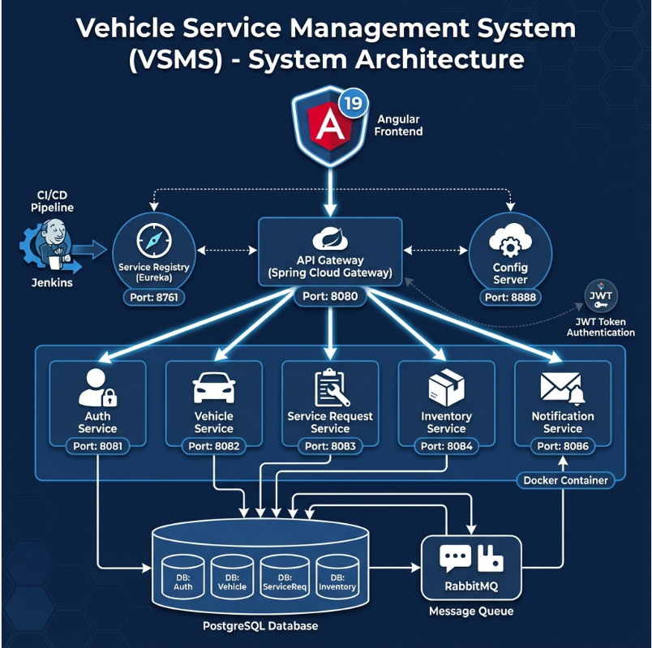
Microservices with Service Discovery The system is built using 5 independent microservices registered with Eureka. The API Gateway dynamically discovers services and routes requests, enabling automatic load balancing and easy scalability without hardcoded endpoints.
Centralized API Gateway All client requests pass through a single API Gateway (port 8080), which handles JWT authentication, role-based access, and CORS. This centralizes security and keeps individual microservices lightweight.
Event-Driven Notifications The system uses RabbitMQ for asynchronous communication. Events like customer registration or technician approval are published to a queue and processed by the Notification Service, ensuring loose coupling and non-blocking operations.

Slide 8
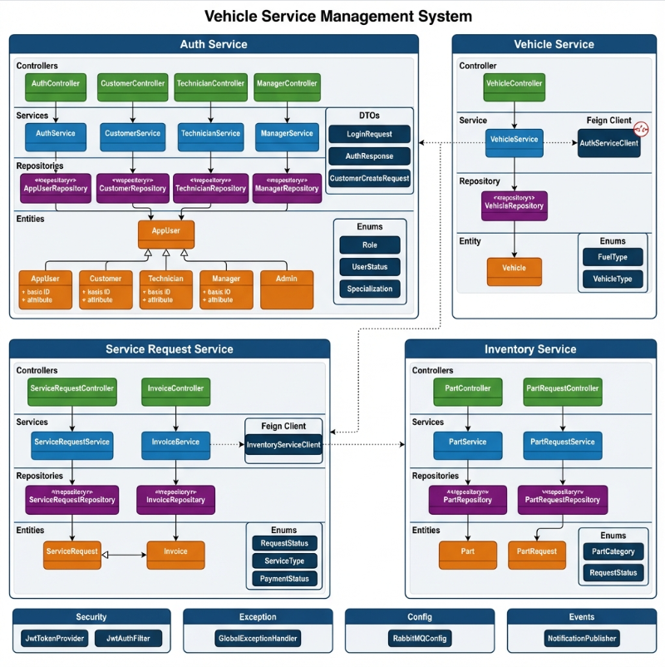
Layered Architecture Pattern Each microservice follows a clean layered structure (Controller → Service → Repository → Entity). This clear separation of concerns improves maintainability, testability, and code clarity.
Inter-Service Communication with Feign Clients Microservices communicate using Feign Clients with a Circuit Breaker. If a dependent service is unavailable, the circuit breaker provides a graceful fallback, preventing cascading failures.
DTO-Based API Contracts All APIs use DTOs instead of exposing JPA entities directly. This ensures data security, clean contracts, and flexibility to change internal models without impacting clients.

Slide 9
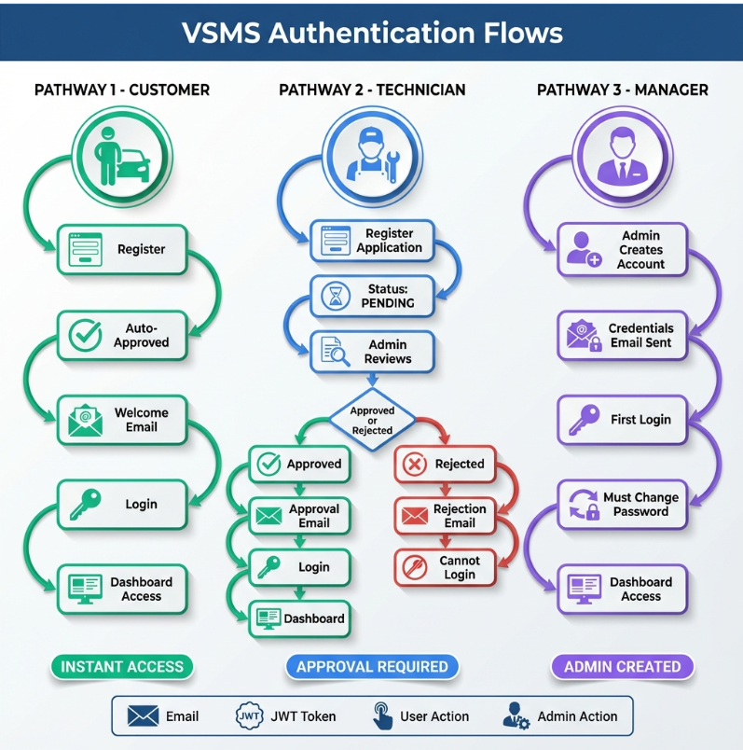
SECURITY FLOW

Slide 10
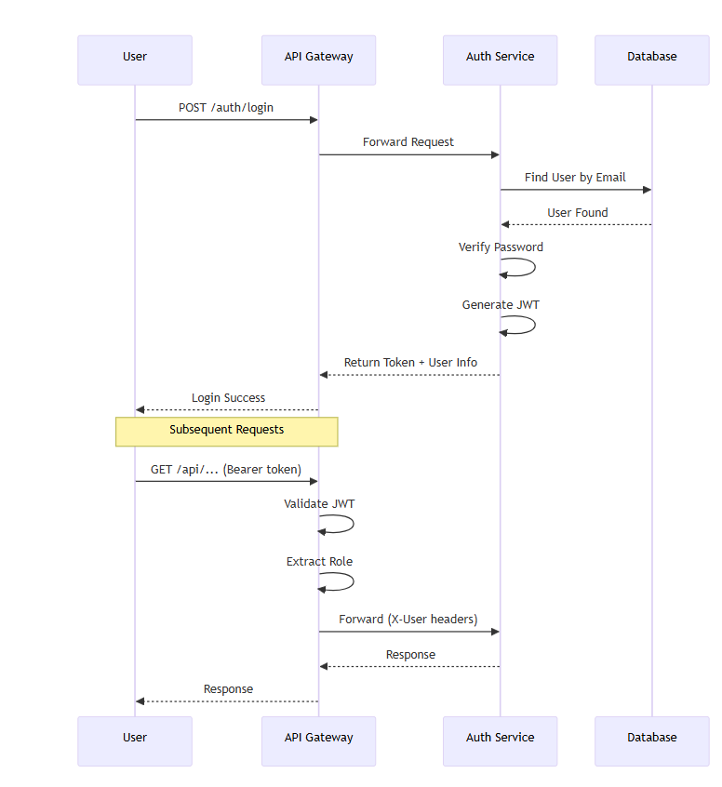
Authentication Flow

Slide 11
FRONTEND DASHBOARDS

Slide 12
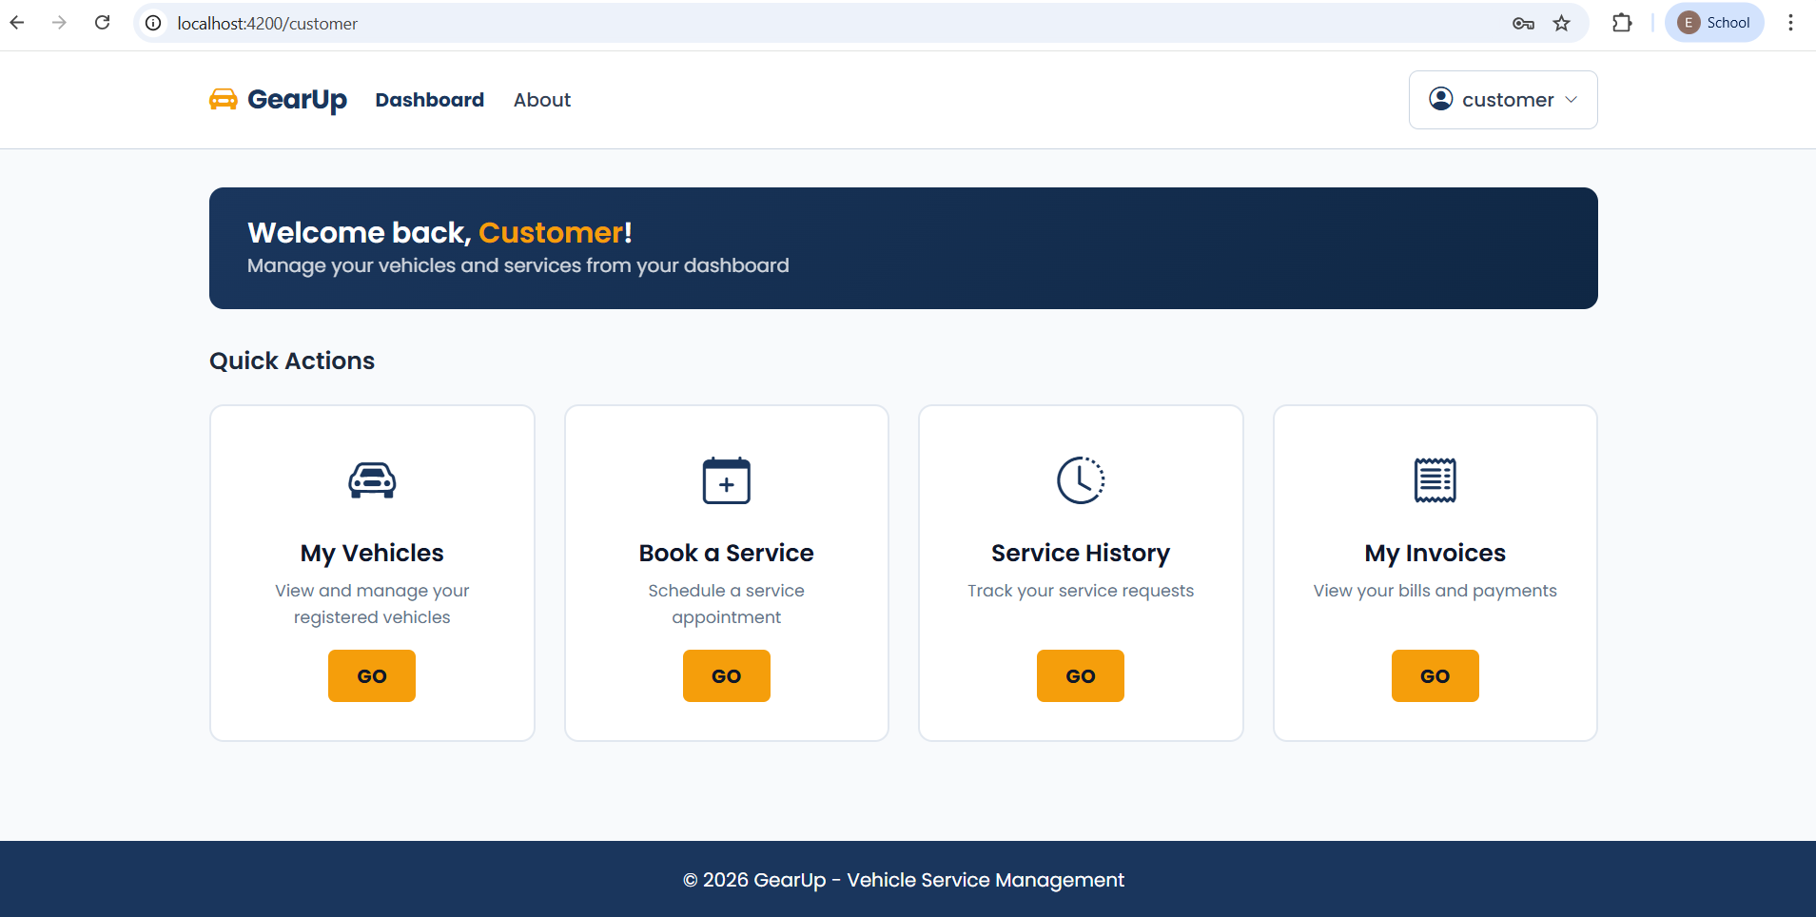
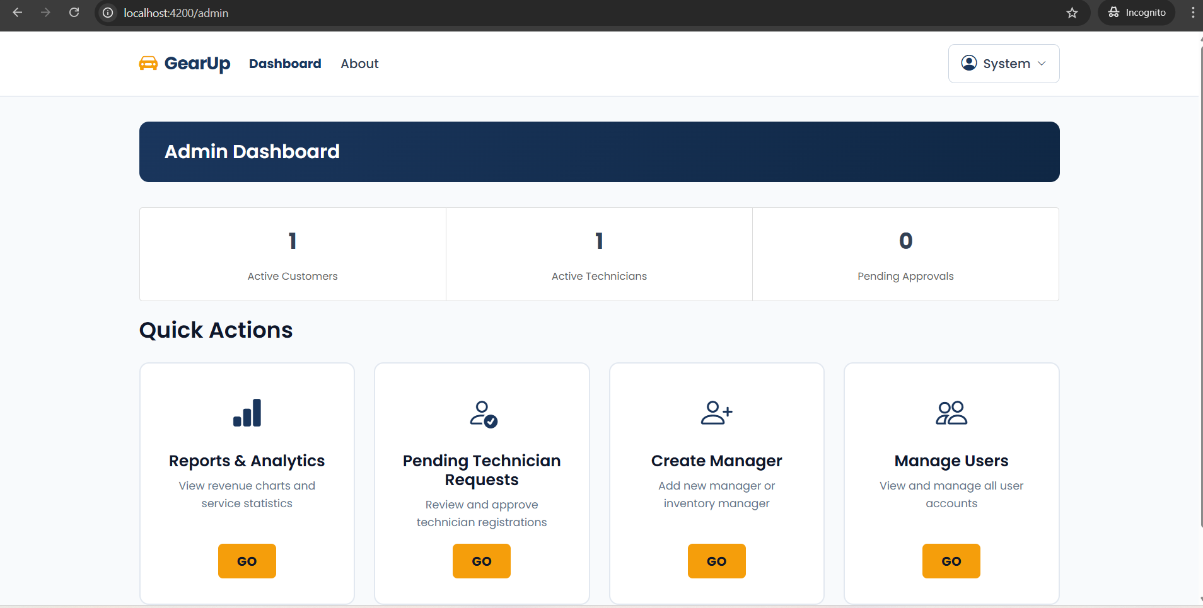
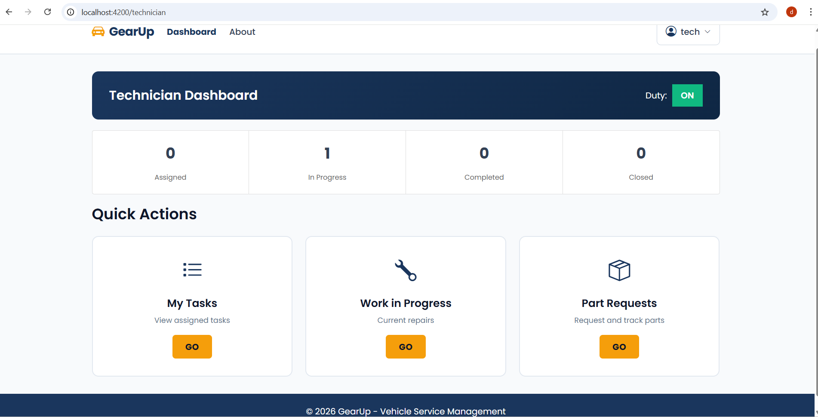
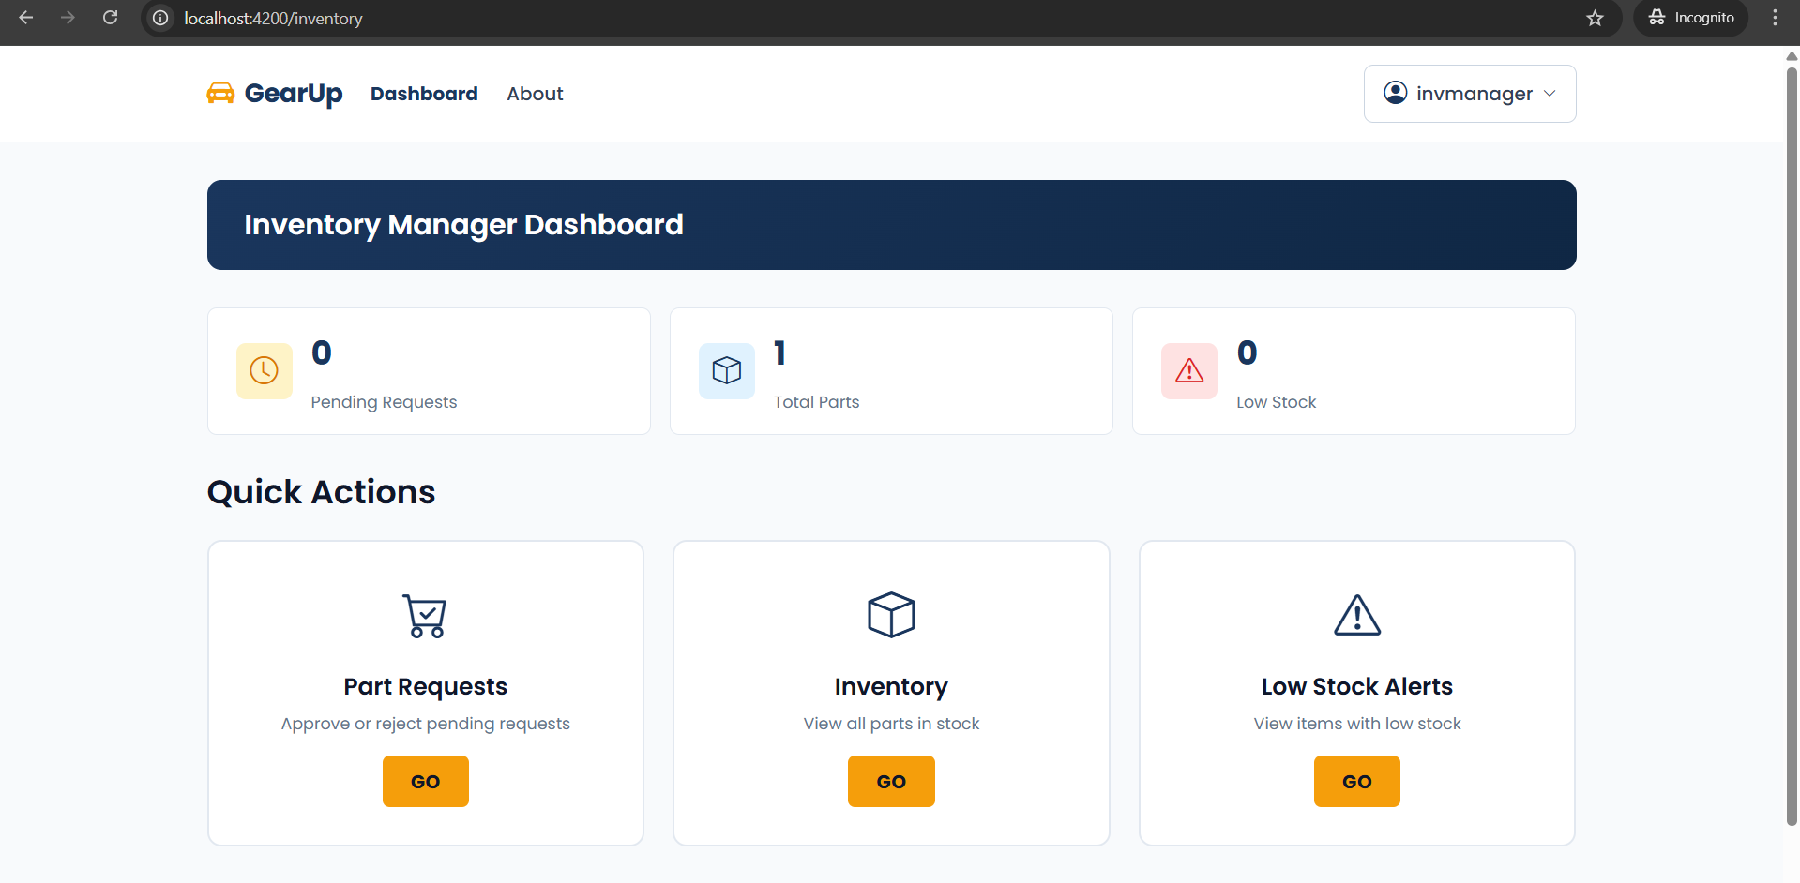

Slide 13
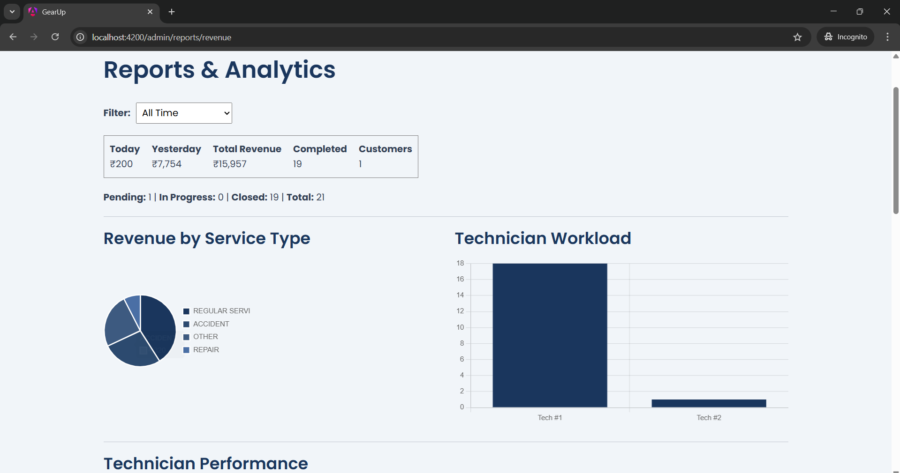
Reports and analytics

Slide 14
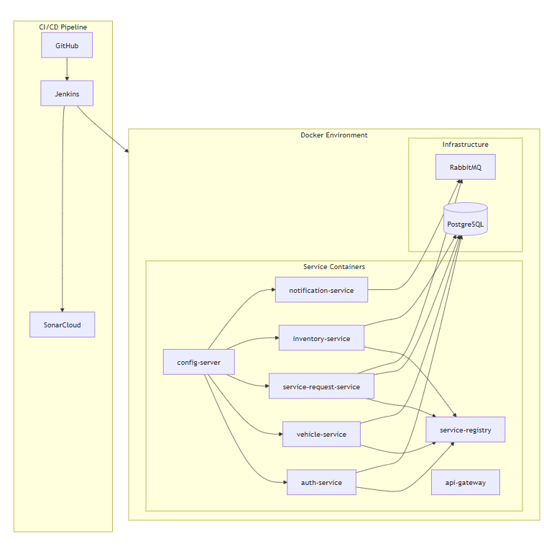
Deployment Build

Slide 15
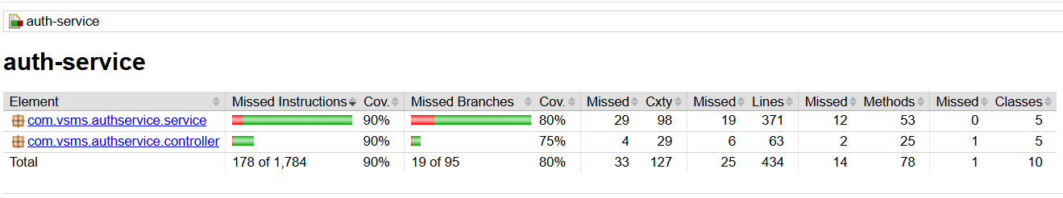
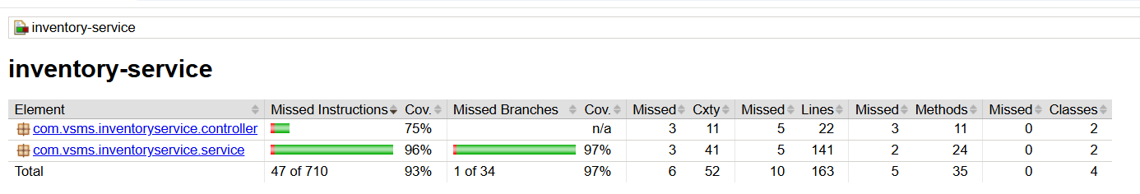
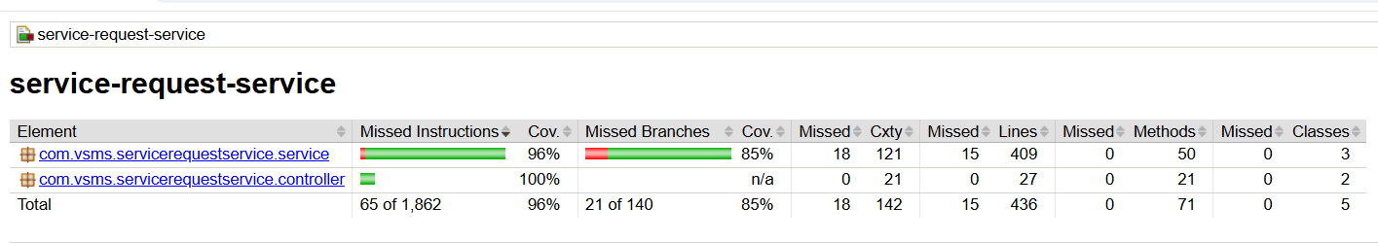
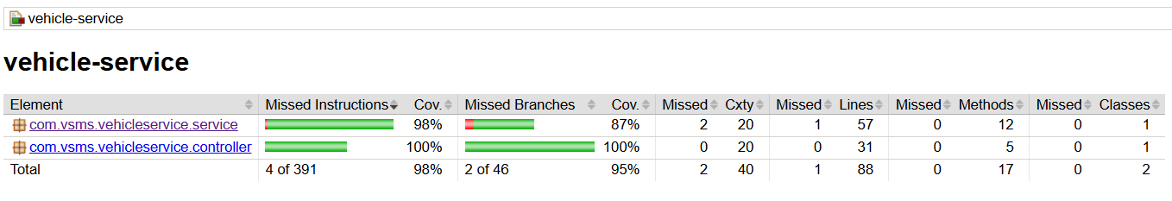
JaCoCo reports

Slide 16
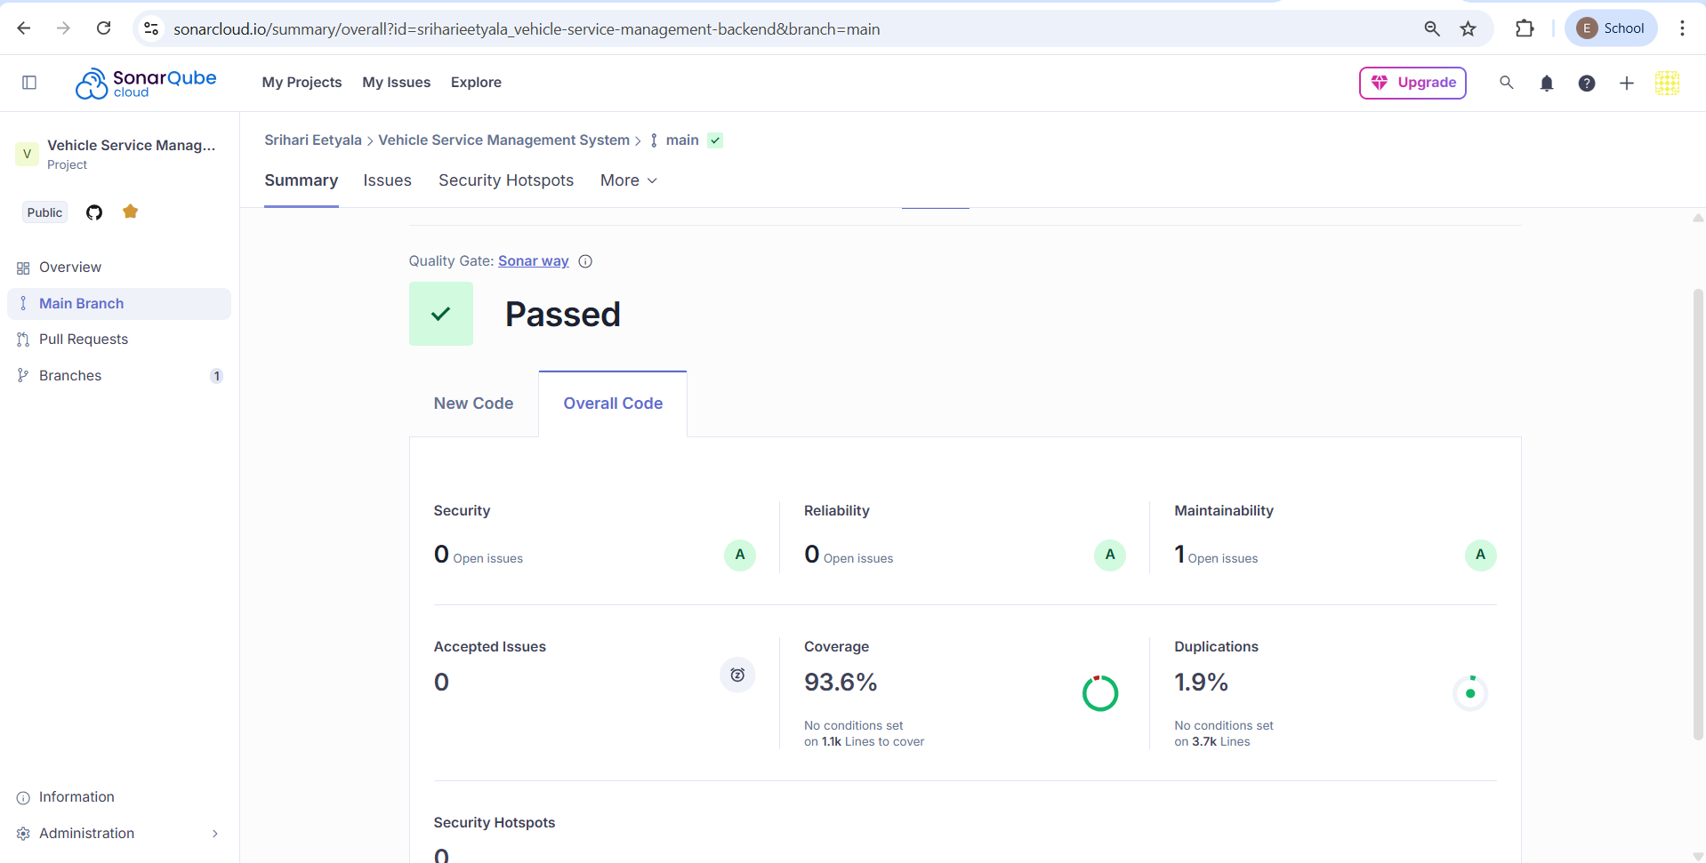
SonarCloud Analysis:

Slide 17
RESULTS
Successfully delivered all planned features - Complete end-to-end workflow from customer registration to invoice payment
Event-Driven Architecture - Implemented RabbitMQ messaging for real-time email notifications (7 event types: welcome, approval, invoices, etc.)
Fault Tolerance - Added Circuit Breakers on API Gateway for all 4 microservice routes
Optimized Docker Builds
93%+ Code Coverage - Comprehensive unit tests across all services using JUnit & Mockito
SonarQube Clean Code - Fixed 35+ code smells, reduced total issues

Slide 18
THANK YOU

